Slide 1


AutoDiff: John Gilbert Style
what I imagine to be
Alan Edelman
(Ekin Akyürek, Yuyang Wang)
June 3rd, 2023

Slide 2
Outline
talk about john being at mit in 2003-2004
bringing viral to me
tell some story or another
basic idea
the elimination and connect to sparse days
also the augmentation
then to neural networks (which I think we can explain better)
finally operators
and the code
multiple dispatch , generic programming, and not so much the overloading
since we all know that everything should be viewed with graphs and matrices, tell a story about autodiff the way I imagine that john might have thought about it

Slide 3
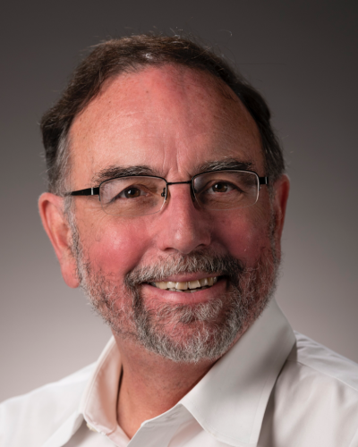

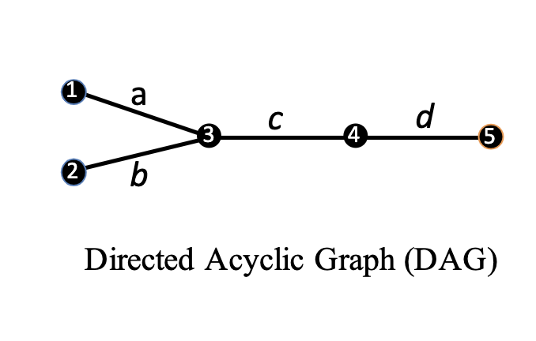
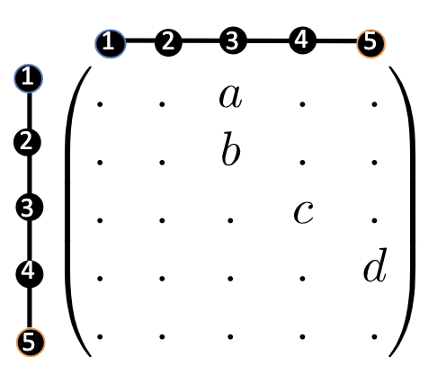
Graphs
DAGs!
Matrices
image: <a href="https://www.freepik.com/free-vector/isolated-justice-scales-symbol-white-background_30833713.htm#query=balance%20symbol&position=1&from_view=keyword&track=ais">Image by brgfx</a> on Freepik

Slide 4
Graphs and Sparse Matrices: Cholesky factorization
Fill: new nonzeros in factor
How many of you
haven’t seen this
slide?
made for 18.337/2004
Sparse days I?
1
3
7
1
3
7
Symmetric Gaussian elimination:
for j = 1 to n add edges between j’s higher-numbered neighbors
8
6
8
6
4
10
4
10
9
5
2
9
5
2
G(A)
G⁺(A) [chordal]

Slide 5
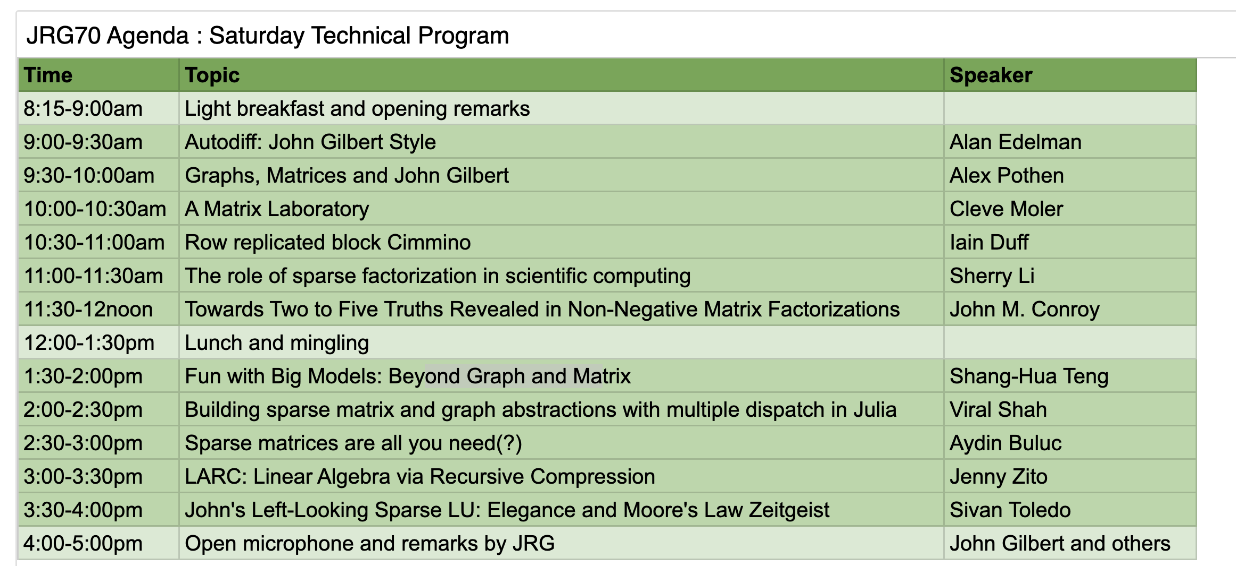

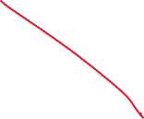
John Gilbert: The interplay between graphs and matrices

Slide 6
Graphs and Matrices
In the end it is a notation
From a deep mathematical view, there is no distinction
But the interplay is amazing in how we understand

Slide 7
Automatic Differentiation Scalar Example: sin(1/x)
Forward Mode: (-1/x²)*cos(1/x) (left to right)
Reverse Mode: cos(1/x)*(-1/x²). (left to right)
Everyone says that automatic differentiation is really just the chain rule …
I say, it’s just linear algebra and graph theory!

Slide 8

Path Weights
a
ab
abc
abcd
1
1
Forward Path Weights
a
b
c
4
d
1
2
3
5
Chain with edge weights
Source Sink
abcd
bcd
cd
d
5
Backward Path Weights
1
2
3
4
5
1
2
3
4
5
Edge Weights Matrix
Path Weights Matrix
b,bc black, bcd orange

Slide 9
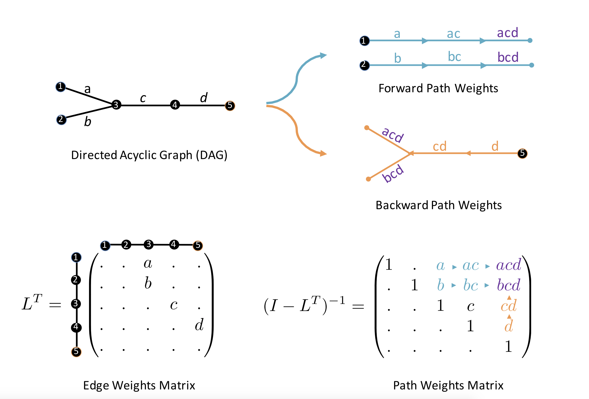
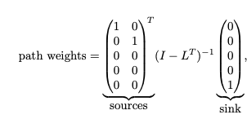
Path Weights
Sources Sink
from sources
to sink

Slide 10
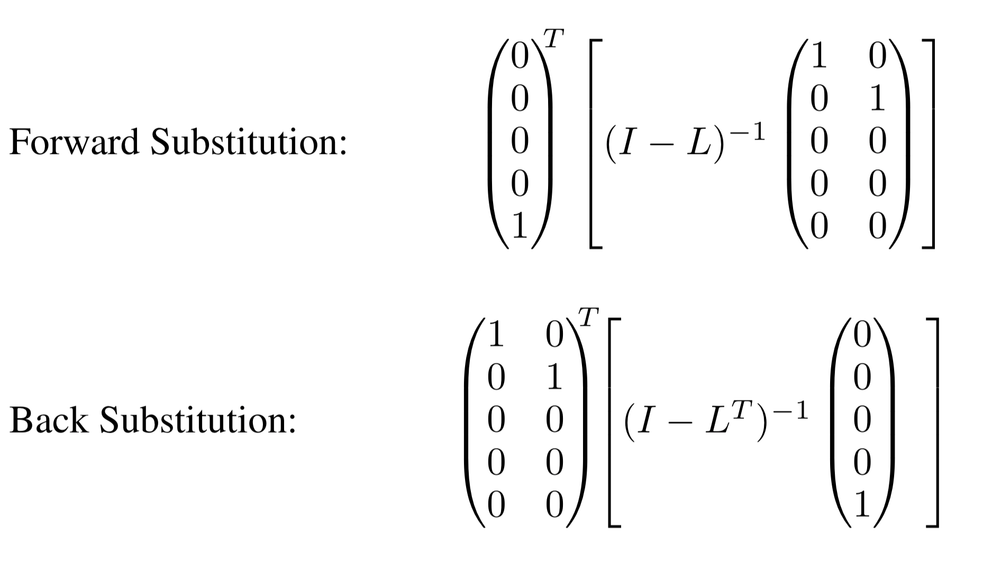
How to Compute

Slide 11
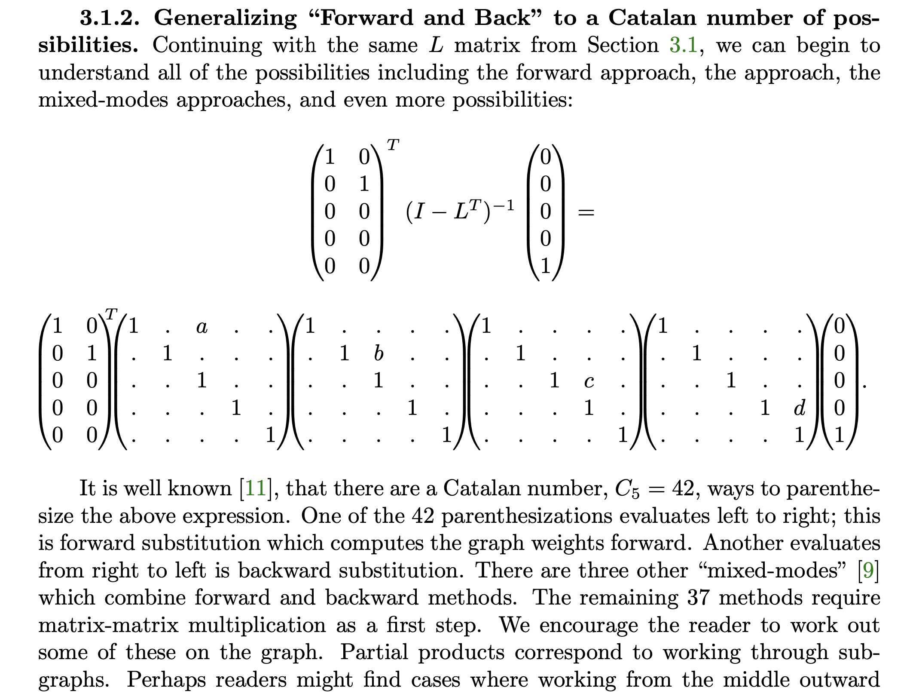

Slide 12
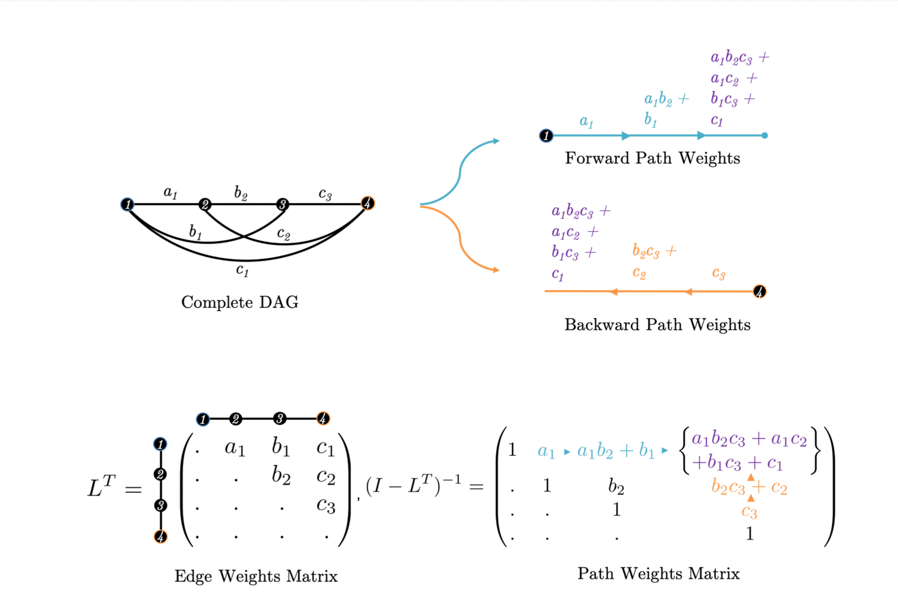
Example: The Complete DAG
Note the symmetry between forward and backward in this case.

Slide 13
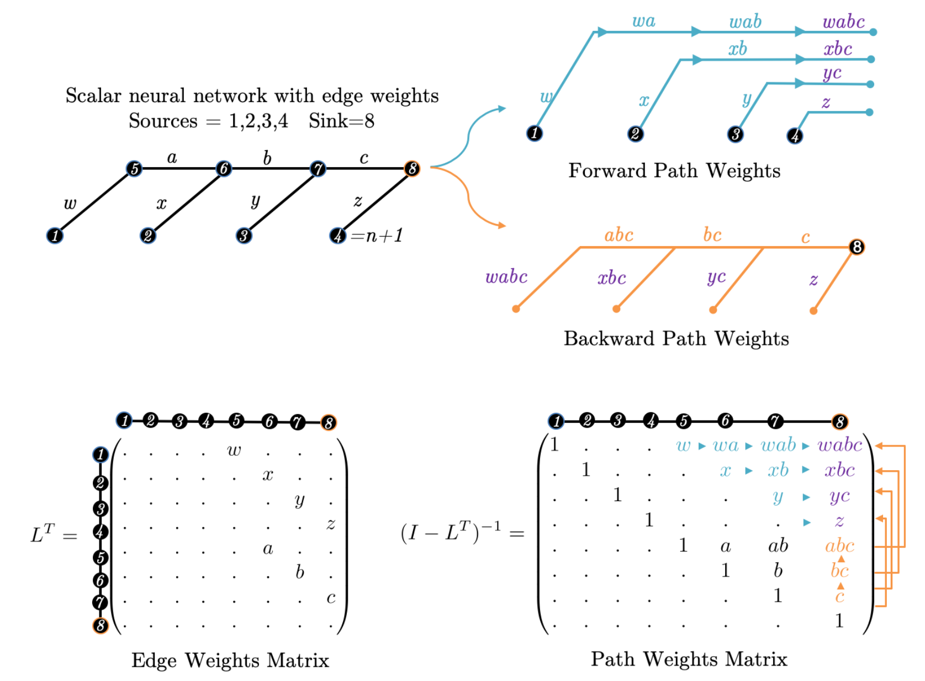
Example: Scalar MLP

Slide 14
Example: Scalar MLP
“Natural
Block
Decomposition”
Source — Internal
Internal—Internal

Slide 15
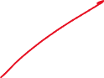
Edge Elimination
eliminate edge 3-4
Directed Acyclic Graph
Edge Weights Matrix
1
a
1
ac
c
d
d
3
4
5
3
5
2
b
2
bc
Forward Path Weights
a
ac
acd
ac
acd
1
1
b
bc
bcd
bc
bcd
2
2
Path Weights Matrix
Backward Path Weights
acd
acd
cd
d
d
5
5
bcd
bcd

Slide 16
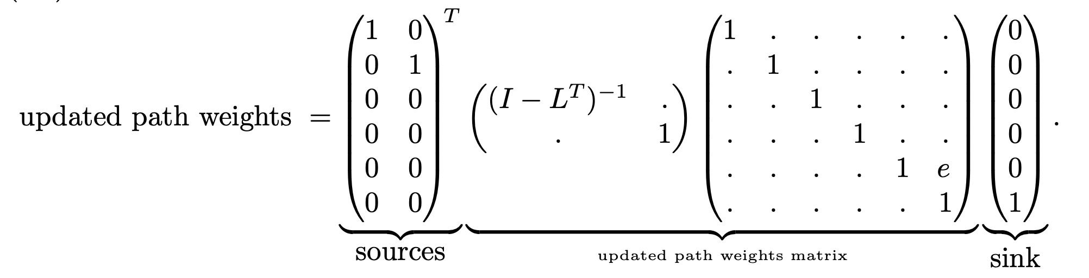
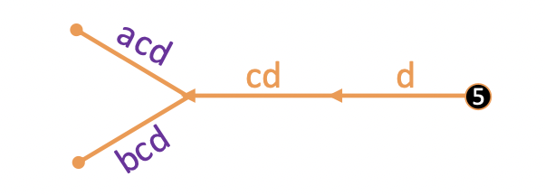
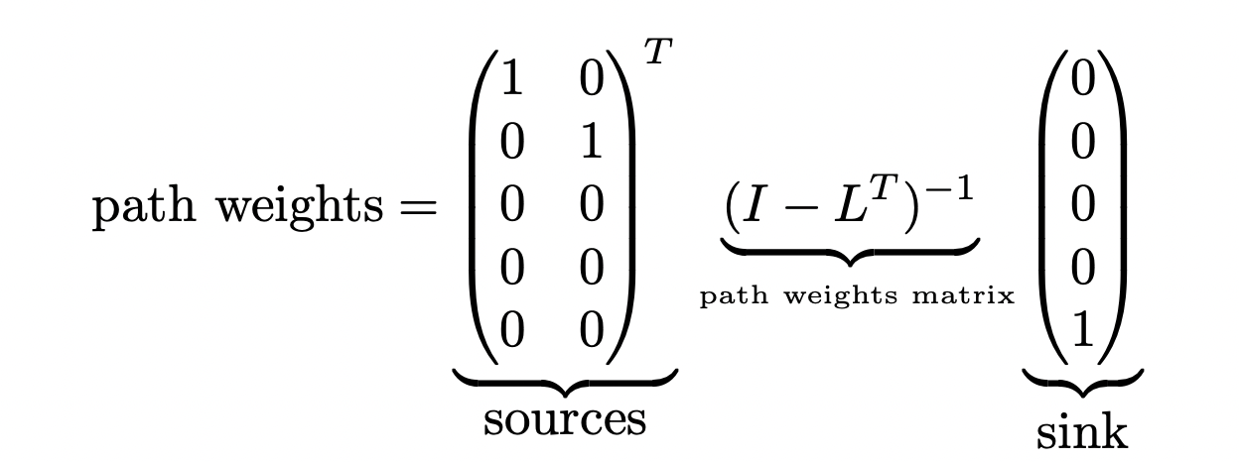
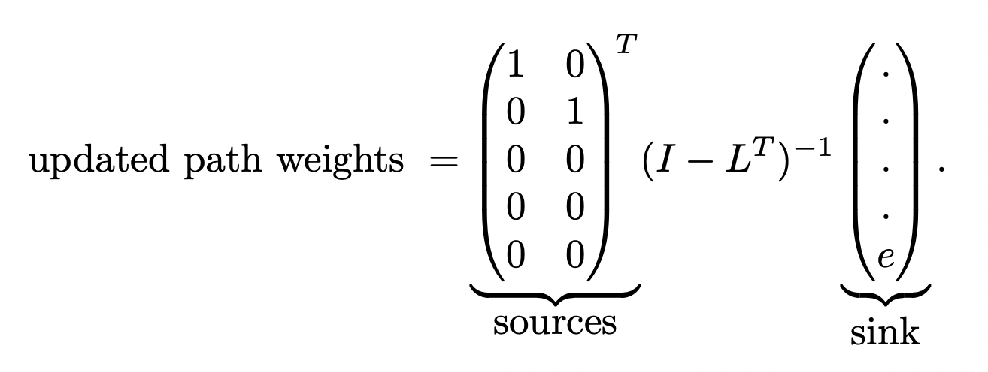
Add an edge e
Edge Addition

Slide 17
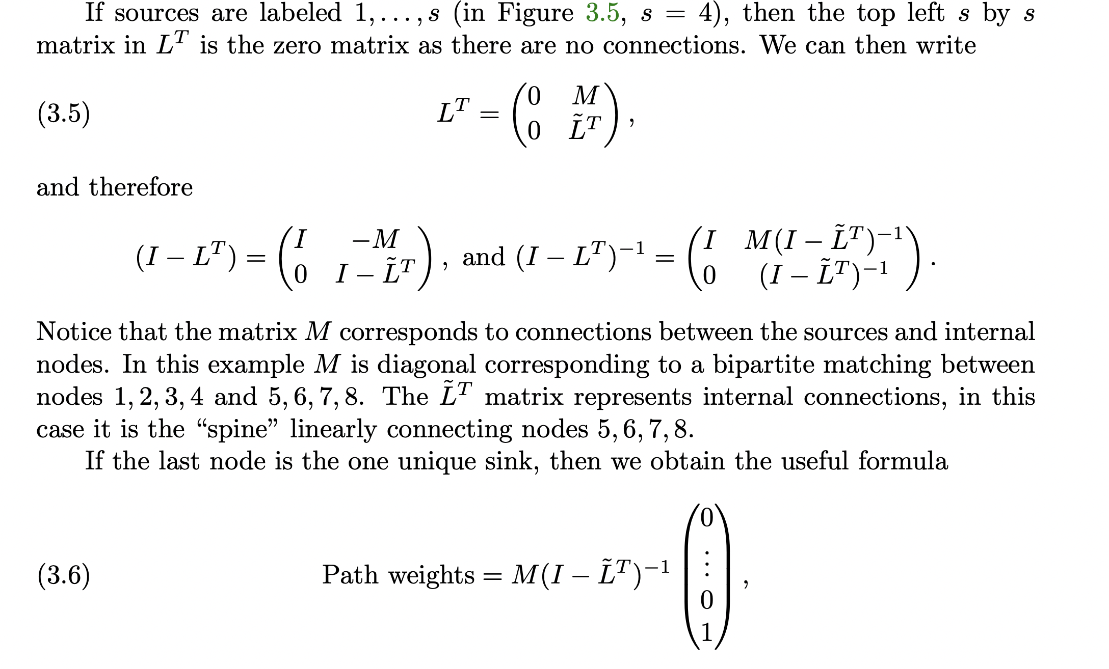
Remember that Block Decomposition? M: source-internal, \tilde{L}: internal internal

Slide 18
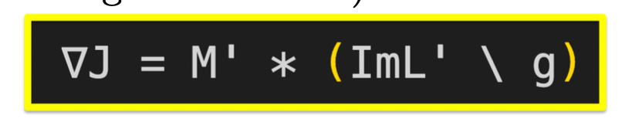
Putting it all together

Slide 19
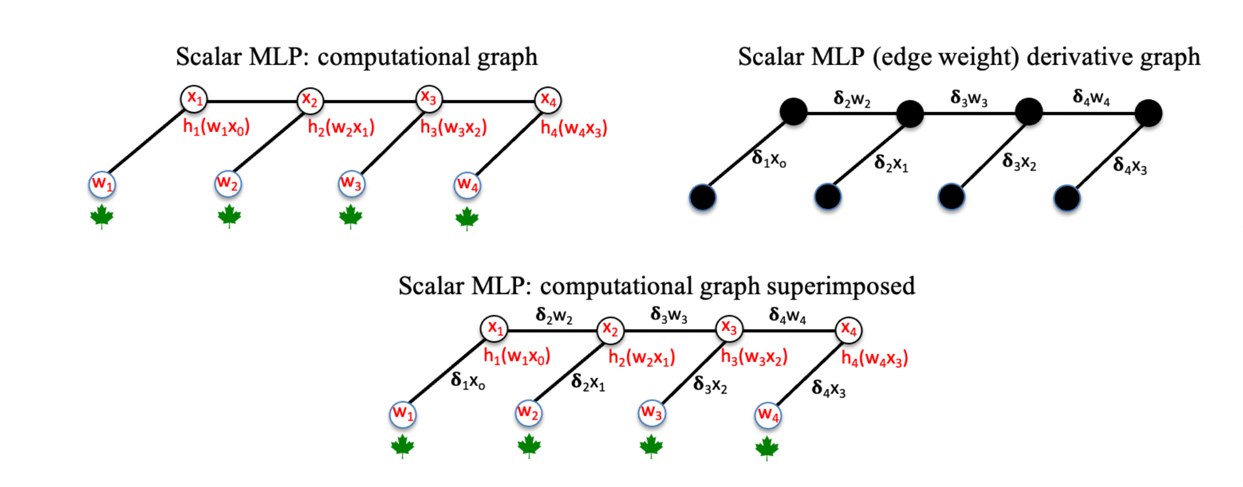
Wait: where are the derivatives?
Vertices:Computational
Graph
Edges: ”One step” derivatives

Slide 20
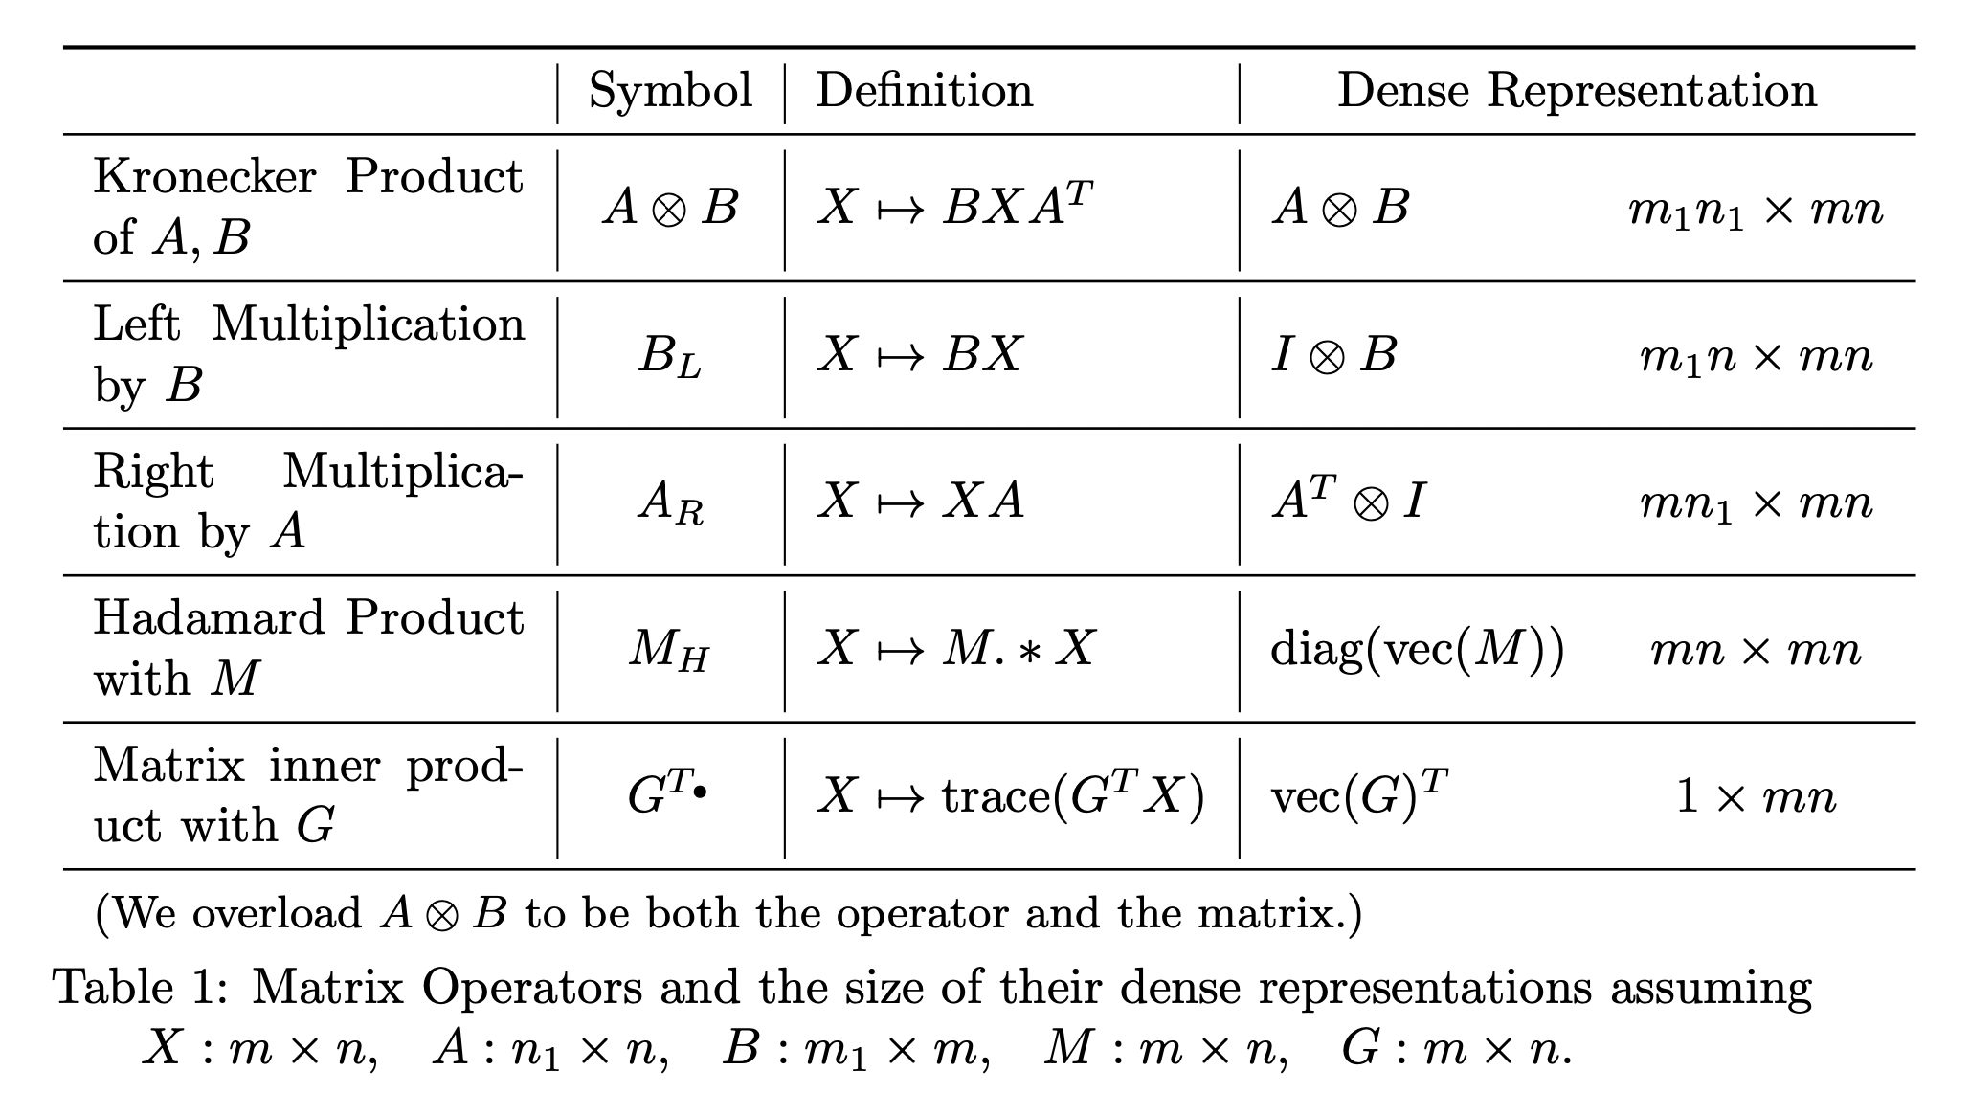
Matrix Operators

Slide 21
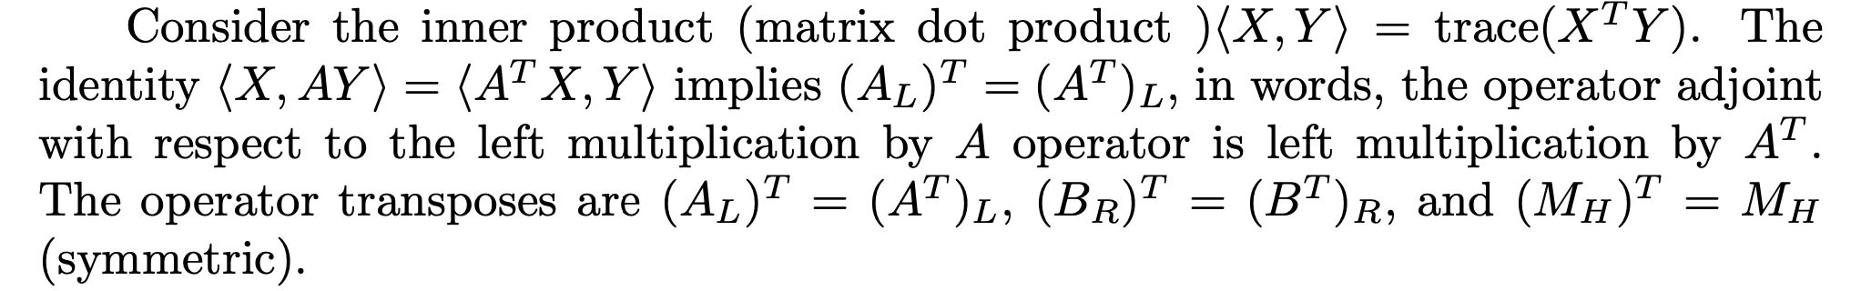
Matrix Adjoints

Slide 22
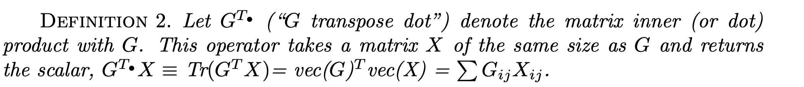

Slide 23
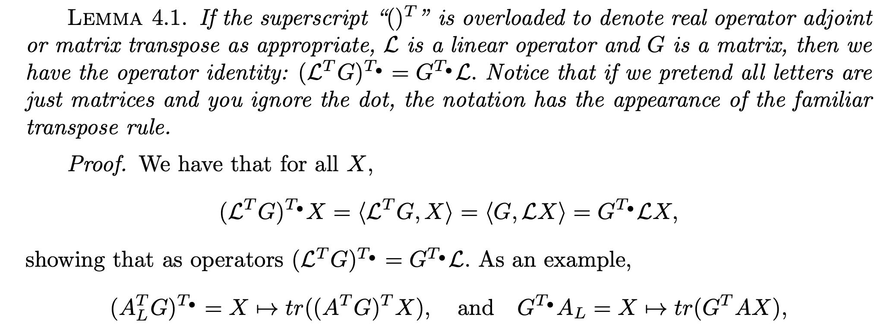
Why this notation is nice!

Slide 24
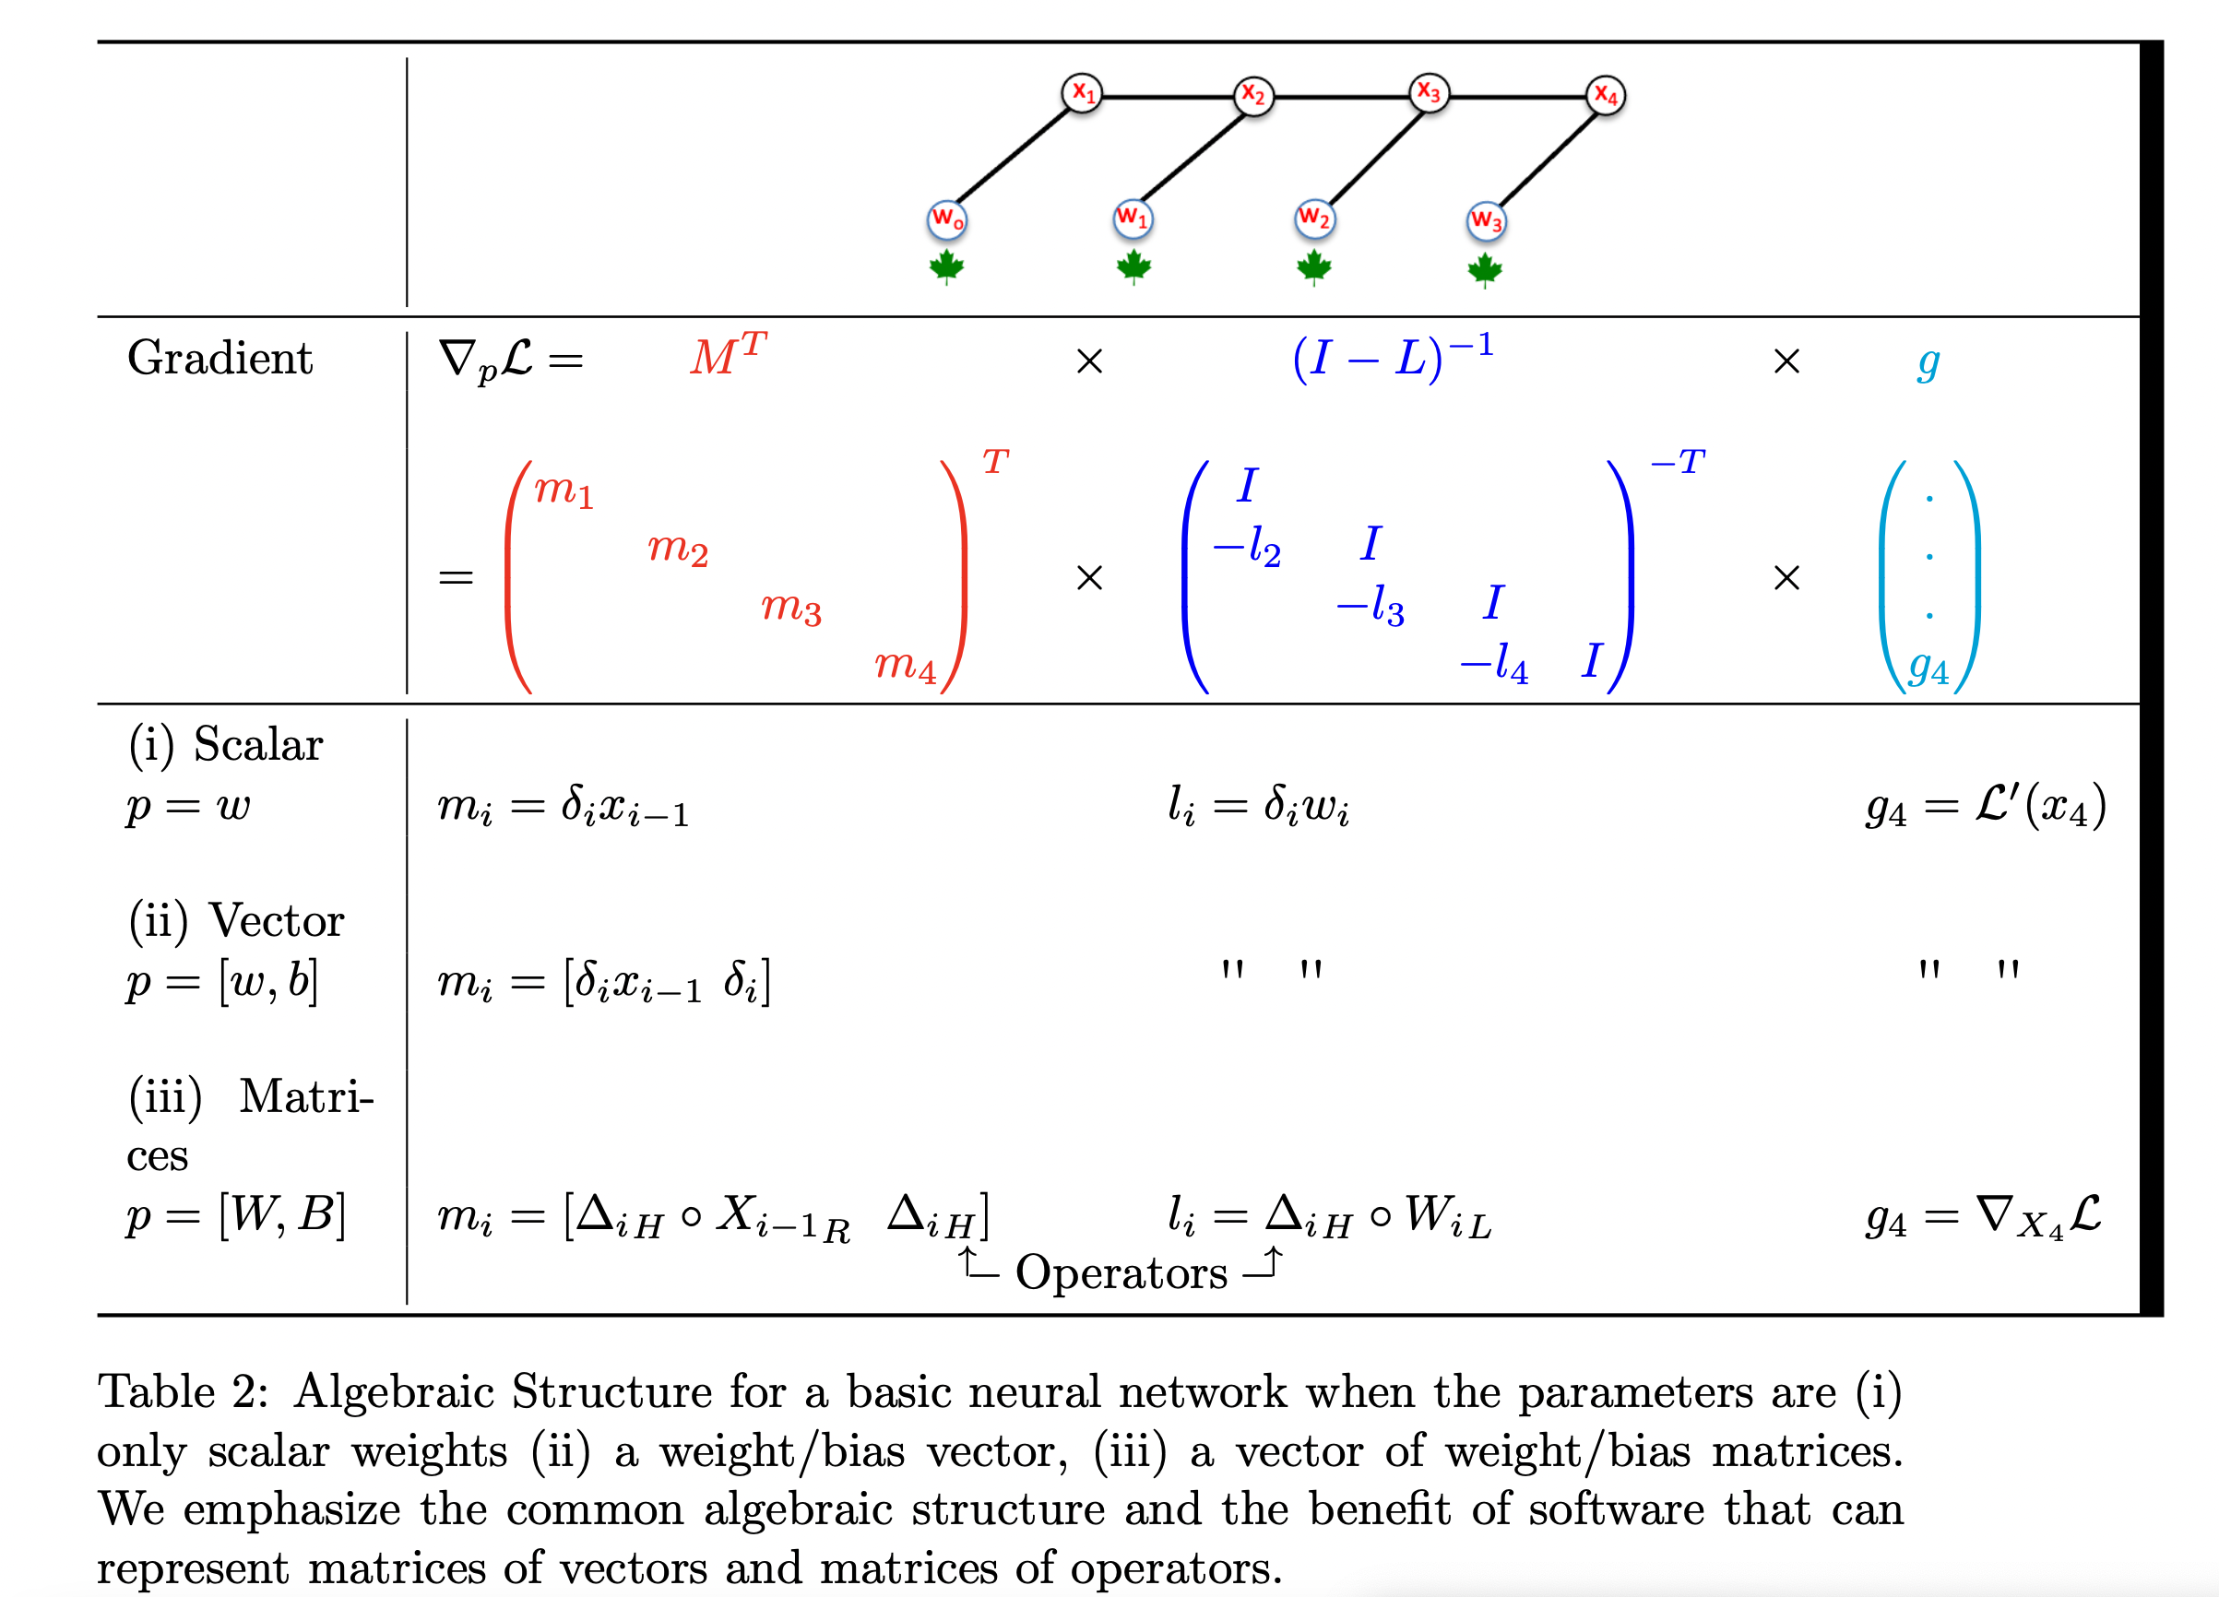
From scalar to vector to matrix networks

Slide 25
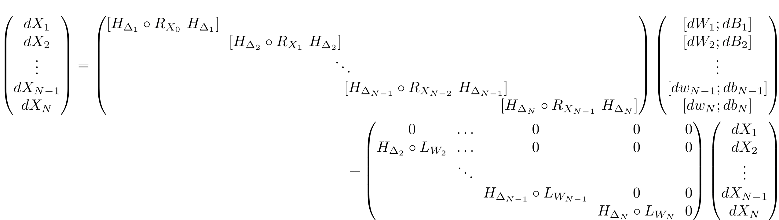
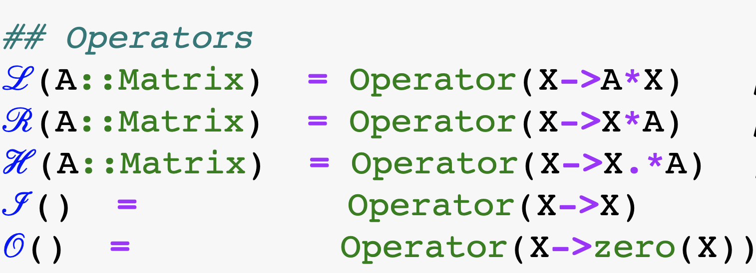

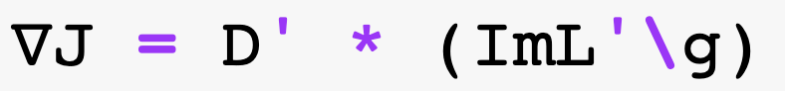
Neural Net with Operators
(Generally triangular!)

Slide 26
Demo

Slide 27
Some CS points
Modern Computer Science Meets Linear Algebra:
Generic Programming
Note: backslash is not lapack’s backslash which isn’t generic
Composablity
Transpose all the way down
Contraversy:
Performance

Slide 28
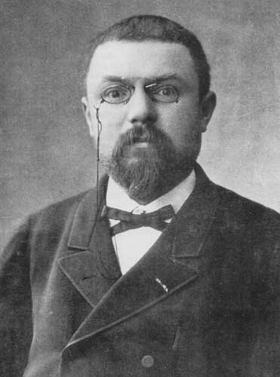
Abstraction
… mathematics is the art of giving the same name to different things. It is enough that these things, though differing in matter, should be similar in form, to permit of their being, so to speak, run in the same mould. When language has been well chosen, one is astonished to find that all demonstrations made for a known object apply immediately to many new objects: nothing requires to be changed, not even the terms, since the names have become the same.
Henri Poincaré
over 100 years ago

Slide 29
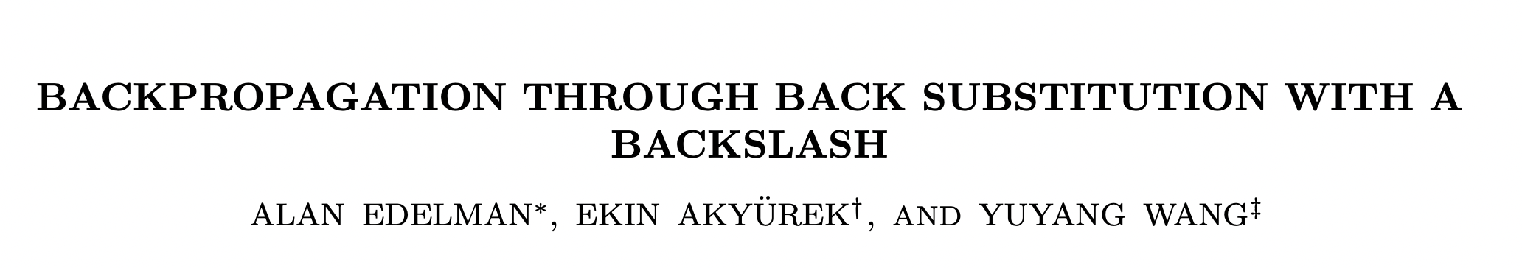
Conclusion:

